Slide 1
Video 9 - Validity and reliability
Steve Simon

Slide 2
Learning objectives
To discuss the importance of measurement reliability
To describe methods of assessing measurement reliability
To discuss the importance of measurement validity
To describe methods of assessing measurement validity

Slide 3
Learning objectives
To define internal validity
To define external validity
To discuss factors that determine the appropriate sample for a research project
Notes:
Here are the objectives for this week.

Slide 4
Required reading
Chapters 11, 12
Green et al. “Development and evaluation of the Kansas City Cardiomyopathy Questionnaire: A new health status measure for heart failure”

Slide 5
Optional Resources
Radloff. “The CES-D Scale: A self-report depression scale for research in the general population”
L.G. Portney & M.P. Watkins. Chapter 5 “Reliability of measurements;” Chapter 6 “Validity of measurements.” Foundations of Clinical Research: Applications to Practice, 3rd ed. Upper Saddle River, New Jersey: Pearson Prentice Hall.
Notes:
This is what you should have read already. If you haven’t done the reading yet, pause this video and read this material. You’ll get more out of the video if you do so.

Slide 6
Three types of validity
Internal validity
“The extent to which we can infer that the independent variable caused the dependent variable.”
External validity
“The extent to which the findings will generalize to other populations, settings, measures, and treatments.”
Measurement validity
“The quality of accuracy of individual measures or scores. The extent to which a score measures what it was intended to measure.”
“Study quality also depends on the consistency (measurement reliability) and accuracy (measurement validity) of the specific instruments”
Notes:
The two articles Green et al, Ratliff et al will be the focus of discussion activities. Conistent and free from error, reproducible. It is measuring what it is intended to measure.

Slide 7
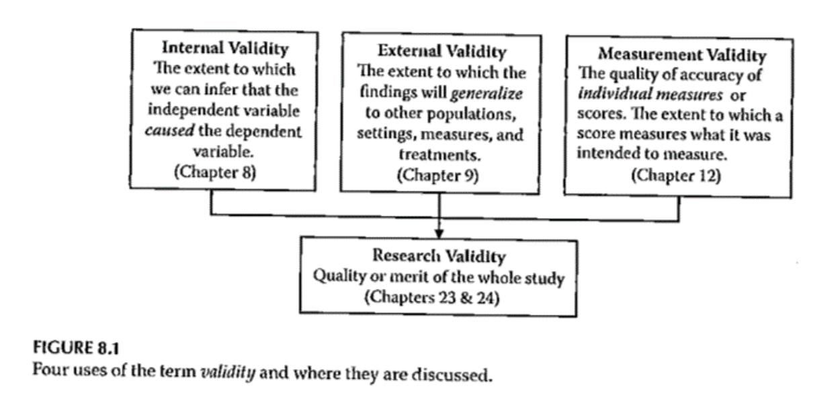
Validity
Notes:
Figure 8.1 has a very concise presentation. Three different types of validity that feed into what a study does. This lecture is just about internal validity. The extent to which you can infer that the independent variable caused the dependent variable.

Slide 8
Internal Validity
“The extent to which we can infer that the independent variable caused the dependent variable.”
For non-experimental studies –
How “well designed and conducted” was the study?
Three criteria for causality
Notes:
It’s really only randomized trials that can establish causality. But even in quasi-experimental and non-experimental studies, you can still talk about internal validity.
The cause has to precede the effect, it must be connected to the effect, and there must be no other variables that could explain why the cause is related to the effect.

Slide 9
Internal Validity
“The extent to which we can infer that the independent variable caused the dependent variable.”
Three criteria for causality
IV must precede the outcome variable
IV must be related to the outcome
There must be no other variables that could explain why the IV is related to the outcome

Slide 10
Internal Validity
Three criteria for causality –
IV must precede the outcome variable
IV must be related to the outcome
There must be no other variables that could explain why the IV is related to the outcome
By Research Approach –
Randomized Exp
Quasi- Exp
Comparative
Associational
Descriptive

Slide 11
Internal Validity
Notes:
For randomized designs, the cause precedes the effect, the cause is related to the outcome and there are no other variables that could explain the relationship.

Slide 12
Internal Validity
Meeting the 3 causality criteria based on –
Strength of the research design
Internal validity
Notes:
The strength of the research design and the internal validity determine whether you can claim causality. Try to design the study to maximize internal validity.

Slide 13
Internal Validity
Internal validity -
Most often discussed with reference to randomized experimental and quasi-experimental designs
Can also be applied to non-experimental studies

Slide 14
Internal Validity
Evaluating the internal validity of a study –
Equivalence of the groups on participant characteristics
Control of extraneous experiences and environmental variables
Notes:
There are two aspects of internal validity, equivalence and control.

Slide 15
Internal Validity
Equivalence of the groups on participant characteristics –
Are groups equivalent prior to introduction of IV?
Randomized experimental design –
Random assignment
Quasi-experimental design –
Random assignment of treatments
Matching
Checking pretest scores
Notes:
Random assignment assures equivalence of the two groups on average. A rule of thumb is 30 people assigned to each group should give you confidence that random assignment will assure equivalence. If you are using random assignment, you should not need to test for baseline equivalence. We feel that random assignment is the best way to achieve equivalence.
In quasi-experimental design, you don’t have random assignment, but you can randomly assign between the two groups. You can also use matching to achieve equivalence. Finally, you can check baseline scores for equivalence.

Slide 16
Internal Validity
Equivalence of the groups on participant characteristics –
Are groups equivalent prior to introduction of IV?
Comparative design –
Statistical adjustment (ANCOVA) to adjust DV scores to make groups more nearly equivalent
Matching participants on variables other than the primary IV
E.g. Case-control study
Check after the study for comparability
Notes:
Since non-randomized trials have an attribute variable, you need to rely on statistical adjustment or matching. You can also check after the study for comparability.

Slide 17
Internal Validity
Equivalence of the groups on participant characteristics –
Are groups equivalent prior to introduction of IV?
Associational design –
Only 1 group
Not able to provide evidence of causation
“Equivalence” – “… whether those who score high on the IV … are similar to those … who score low in terms of other attributes that may be related to the DV.”
May be able to provide some statistical control
Notes:
Equivalence when you have a continuous independent variable means that those who score high on the variable are similar to those who score low.

Slide 18
Internal Validity
Control of extraneous experiences and environmental variables –
Extraneous variables – variables other than the IV and DV
Environmental variables – conditions/variables that occur during the study
Contamination
Issue – Is one group affected more than the other(s)?
Less of an issue with a more controlled research setting
Notes:
Your study could be contaminated by other variables. These variables might be out of your control but which can influence the outcome.
Contamination: people in the intervention group are friends with the control group and share information.
The key issue is whether one group is more affected by extraneous variables.
In a controlled setting, there are fewer extraneous variables, but this changes in a field setting.

Slide 19
Internal Validity
Rating the dimensions of internal validity
Figure 8.2
Evaluating Research Validity framework
“Good” study – moderate to high internal validity on both dimensions
Notes:
Internal validity is measured by whether the two dimensions are addressed.

Slide 20
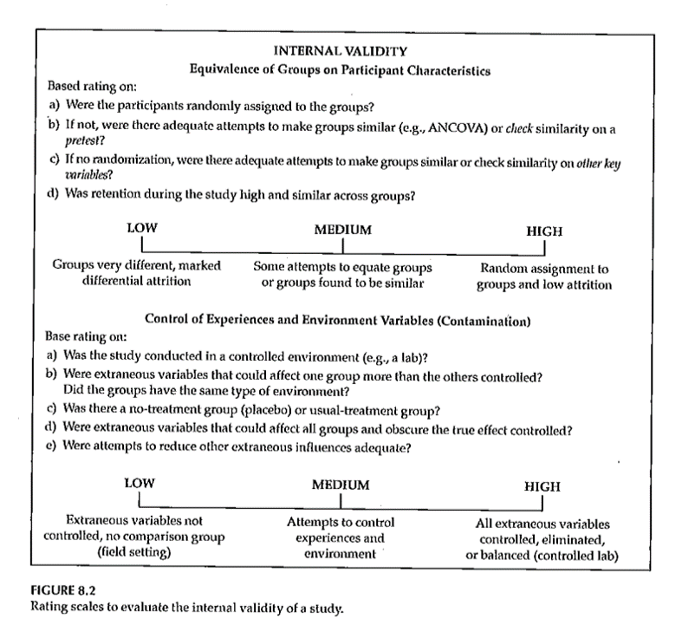
Internal Validity
Rating the dimensions of internal validity
Notes:
Figure 8.2.

Slide 21
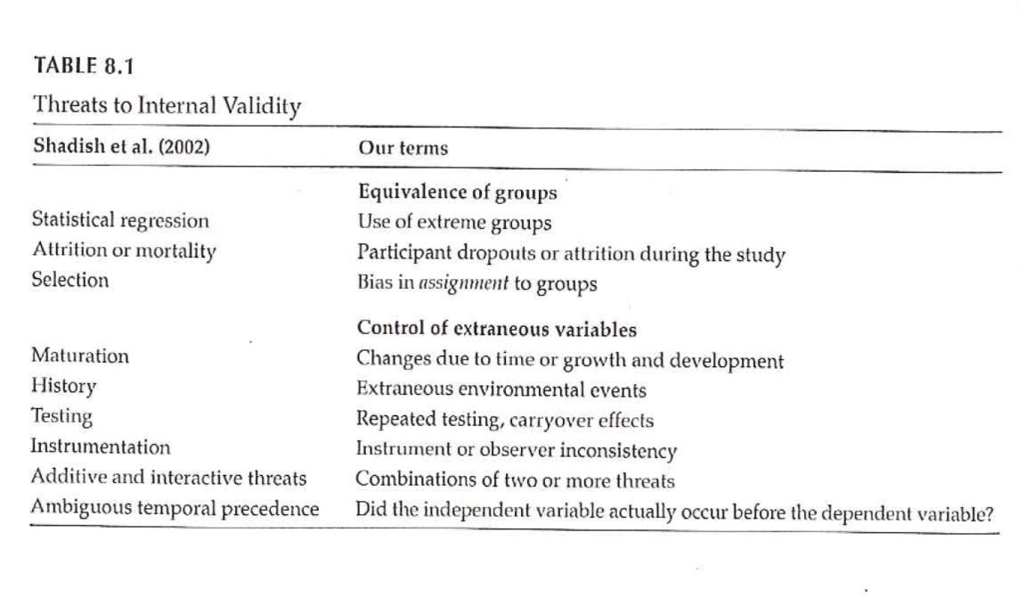
Threats to Internal Validity
Notes:
Table 8.1 relates statistical terminology to identify threats to internal validity. This table tries to take those technical terms and express them
Extreme groups have issues with regression to the mean. Even without any intervention, the extremities will tend to lessen.
Dropouts or attrition means that you’ve designed a setting that is so difficult that no one can stay in. Differential attrition is especially troublesome.
Bias in assignment occurs when patients or their physicians directly or indirectly influence the assignment. Random assignment eliminates this bias.
Cook and Campbell.

Slide 22
Threats to Internal Validity
Equivalence of Groups
Use of extreme groups
Participant dropouts or attrition during the study
Bias in assignment to groups

Slide 23
Threats to Internal Validity
Control of extraneous/environmental variables
Changes due to time or growth and development
Extraneous environmental events
Repeated testing, carryover effects
Instrument or observer inconsistency
Combinations of two or more threats
Did the IV actually occur before the DV?
Notes:
Here are some of the sources of extraneous variables.
Maturation.
History. Something that occurs between the pre and post measurements that is independent of the intervention but which can influence the outcome.
Worry about sensitization to the issue in the baseline measurement that causes people to go out and find more.
Long studies have problems with instrumentation or observers (e.g., because of turnover).
There are also combinations of these events where one magnifies the other.
Temporal order of the variables. If you can’t assure that the independent variable occurs before the dependent variable, you can’t establish causation.

Slide 24
Threats to Internal Validity
Other threats
Effects of being in the control group
Expectation effect
Control for expectation
Observer / experimenter bias
Notes:
Control group contamination. Demoralization.
Hawthorne effect.
Blinding helps control for expectation effects and observer bias.

Slide 25
Validity
Notes:
Here is figure 8.1 again. The next part of this lecture talks about sampling and external validity.

Slide 26
Validity
Notes:
Here is figure 8.1 again. The extent to which results will generalize.

Slide 27
Measurement Reliability
What is measurement reliability?
“… consistency of a series of measurements. ( Cronbach )
“… a property of scores and is not immutable across all conceivable uses of a given measure.” (Thompson)
Importance – without reliable measures, can’t have confidence in study results.
Notes:
We can expect consistent responses. It is able to produce with predictable consistency over time. Without reliability, you have to worry about what the study is telling you.
Suppose you are measuring change from baseline. Unless the scores change in a predictable way. Otherwise, you won’t know if the changes are related to the intervention or if they represent random variation.

Slide 28
Measurement Reliability
Example – Want to determine change in some relevant measure after treatment/intervention.
Baseline measure
Treatment
Follow-up measure
C hange from baseline to follow-up –
Due to effect of treatment?
Due to random variation in the measure?

Slide 29
Measurement Reliability
Observe score
Lab value
Test result
Self-report measure
Classical test theory
Observed score = True score + Error
Change in value – due to change in true score or error?
Notes:
We don’t expect the observed scores to have perfect reliability. There is some fallibility. Something random can occur and people are not always consistent in how they answer things. Measurement error (noise) is messing things up. You want the observed score to reflect the true score more than error.
Systematic error move in a consistent direction. You can often correct for this using calibration. It is often not a problem for reliability, but it will affect validity.
Random errors are errors due to chance. They have unpredictable effects. They usually occur due to unpredictable factors. Less random error means that the observed score more truly affects the underlying true score.
Errors could be due to observer making an error. It is really important to follow established protocols.
Resting heart rate could be influenced by a loud noise, for example. You would hope that this occurs randomly.

Slide 30
Measurement Reliability
Goal – Use measure that
Best reflects the true score
As little “error” as possible
As “reliable” as possible
Measurement reliability –
Coefficient
Ratio – True score / Observed score
Notes:
The reliability coefficient is a ratio of the true score to the observed score.

Slide 31
Measurement Reliability
How much confidence can we have that the measure we obtain reflects the true score?
Reliability of the measure
How variable is the measure
Standard error of measurement –
Allows you to “… establish a range of scores (i.e., confidence interval) within which should lie … true score.”
Notes:
Suppose you want to get at a person’s level of functioning. If the functioning does not change, then the measure does not change. When functioning does change, you want to the measure to change as well.
The standard error places bounds on where the true score lies.

Slide 32
Measurement Reliability
Standard error of measurement –
SEM = SD * SqRt (1 – r)
SEM – Standard error of measurement
SD – standard deviation
r – correlation coefficient
r – indication of the relationship between 2 measures

Slide 33
Measurement Reliability
In order to know the range of true scores that are indicated by the observed score –
Need the SEM to compute a confidence interval around the observed score
Confidence interval –
U sually 95% CI (2 standard deviations)
To have 95% confidence that the range will include the true score

Slide 34
Measurement Reliability
Example – Intelligence test #1
SD = 15; r = .92
SEM = 4.24
Observed score = 110
95% CI <U+F0E8> SEM * 1.96 (z score for 2 SD)
95% CI <U+F0E8> Observed +/- SEM * 1.96
95% CI <U+F0E8> 101.68 – 118.32
Range of scores that includes the true score given 95% CI
Notes:
r is the reliability coefficient.

Slide 35
Measurement Reliability
Example – Intelligence test #2
SD = 15; r = .65 (less reliable measure)
SEM = 8.87
Observed score = 110
95% CI <U+F0E8> SEM * 1.96 (z score for 2 SD)
95% CI <U+F0E8> Observed +/- SEM * 1.96
95% CI <U+F0E8> 92.61 – 127.61
Range of scores that includes the true score given 95% CI
Notes:
If the reliability is lower, then the range of scores is much wider.

Slide 36
Measurement Reliability
Correlation coefficient
For measurement reliability, general rules –
“reliable” .7 to 1.0
More strict criteria
= .90 for measures used to make decisions about individuals
.80 acceptable for research
.70 - .80 somewhat lower than desirable
In practice
Measures used with reliability of .60 and higher
Notes:
It’s not unusual to see reliabilities as low as 0.7 or even 0.6.

Slide 37
Measurement Reliability
Test-retest
Parallel forms
Internal consistency
Split-half
Kuder -Richardson 20
Cronbach’s alpha
Interrater
Percentage agreement methods
Intraclass correlation coefficients
Interrater
Notes:
Reliability is usually established when a measure is developed. When you go about using a measure, look at what’s already been published. Is it used in a context similar to yours. Was the time frame for test-retest reliability comparable to your time frames?
Test-retest reliability is the coefficent of stability (repeatability). This only makes sense in settings where you expect things to remain stable.
Intelligence is likely to be stable along long time frames but mood changes rapidly.
What size interval would you expect the measure to be stable?
Parallel forms, alternate forms. If you are concerned that information known at baseline, just that process of collecting that data might have an influence. You can get at this with using different items, reordering items.
Homogeneity of scale. The extent to which the items are measuring the same underlying construct.
Split half, compare first half versus second half, odd items versus even items, random items. It is not necessarily easy to do because you have to believe that the two items are comparable. Also when you reduce the number of items, this influences the reliability. The Spearman-Brown formula adjusts for this.

Slide 38
Measurement Reliability
Measurement reliability
Generally established when a measure is developed
For your study
Check past reliability of measure
If test-retest, is time period comparable?
Is sample comparable?
Report both established reliability AND reliability coefficient found in your study

Slide 39
Measurement Reliability
Test-retest
Parallel forms
Internal consistency
Split-half
Kuder -Richardson 20
Cronbach’s alpha
Interrater
Percentage agreement methods
Intraclass correlation coefficients
Interrater

Slide 40
Measurement Reliability
Test – retest reliability
Coefficient of stability ( Cronbach )
Test score will be stable if measured at different time points
Timing of testing interval is critical
Test-retest reliability – previously established
Concern if reliability is < .70
Notes:
The average of all possible split half items. It is used with interval response scale.

Slide 41
Measurement Reliability
Test-retest
Parallel forms
Internal consistency
Split-half
Kuder -Richardson 20
Cronbach’s alpha
Interrater
Percentage agreement methods
Intraclass correlation coefficients
Interrater
Notes:
Before you go into this assess the intra-rater reliability. Consistency of a single rater.
Look at percent agreement. How many different events are you going to have raters code for.

Slide 42
Measurement Reliability
Parallel forms reliability
Addresses concerns about “testing” or “carryover” effects
Second or parallel form
Reordering the items
New items
Reliability coefficient of at least .80 is desirable

Slide 43
Measurement Reliability
Test-retest
Parallel forms
Internal consistency
Split-half
Kuder -Richardson 20
Cronbach’s alpha
Interrater
Percentage agreement methods
Intraclass correlation coefficients
Interrater

Slide 44
Measurement Reliability
Internal consistency – Split-Half method
Correlate 2 halves of the same test/survey
1 st half vs 2 nd half
Odd items vs even items
Random sample of half the items vs the other half
Issue – reducing ###of items
Reduces strength of relationship
Underestimate reliability
Adjust using the Spearman-Brown formula

Slide 45
Measurement Reliability
Internal consistency – Kuder -Richardson 20
Measures inter-item reliability
Assuming instrument measures a single trait/construct
Dichotomous item score

Slide 46
Measurement Reliability
Internal consistency – Cronbach’s Alpha
Measures inter-item reliability
Assuming instrument measures a single trait/construct
Interval response scale
Alpha values .70 and higher - acceptable

Slide 47
Measurement Reliability
Test-retest
Parallel forms
Internal consistency
Split-half
Kuder -Richardson 20
Cronbach’s alpha
Interrater
Percentage agreement methods
Intraclass correlation coefficients
Interrater

Slide 48
Measurement Reliability
Interrater Reliability – Percentage Agreement
Two or more raters
Agreement on what will be rated
Each person rates independently
Compute ratio of agreement
Issue –
Agreement on ###of events
Agreement on when events occurred?

Slide 49
Measurement Reliability
Interrater Reliability – Intraclass Correlation Coefficients (ICCs)
Calculate reliability coefficient for more than 2 raters
Must have interval response scale
Computation – ANOVA with repeated measures
How related are the rating by different raters?

Slide 50
Measurement Reliability
Interrater Reliability – Kappa
Calculate reliability coefficient for 2 or more raters
Nominal data
Compute agreement between 2 raters, taking into account “ marginals ”
Notes:
Kappa goes into more than agreement. Compares agreement to the amount expected by chance.

Slide 51
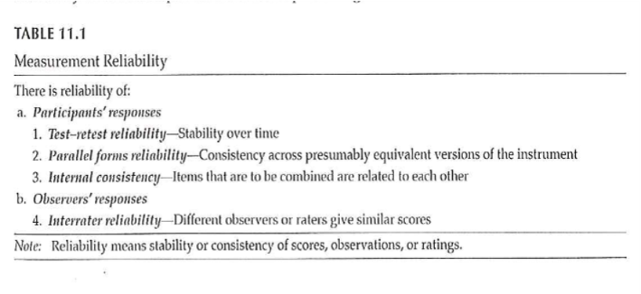
Measurement Reliability
Notes:
From the textbook. Table 11.1. Some get at participant responses. Some get at observer responses.

Slide 52
Measurement Reliability
Theories
Classical test theory
Observed = True score + random error
Generalizability theory
Different components of error
Random error
Test-retest error
Rater error
Other identifiable sources of error
Item response theory
Separate test characteristics from participant characteristics
Notes:
Generalizability theory gets at reliability differently from classical test theory. It looks at facets of reliability.
No one coefficient provides a complete assessment of reliability.
The third theory is item response theory separates test itmes from participant characteristics. All items are not equally revealing.
IRT useful for intelligence tests.

Slide 53
Measurement Validity
“… establishing evidence for the use of a particular measure or instrument in a particular setting with a particular population for a specific purpose.”
Providing evidence for validity
NOT “test is valid” or “test is invalid”
MUST have reliable measure before you can have validity
May have reliability without validity
Notes:
When we develop measures it is with respect to discrimination, evaluation, or prediction. What is the measure intended for? Establishing validity isn’t as simple as establishing validity.
Validity implies that the measure is relatively free from error.

Slide 54
Measurement Validity
Evidence of validity reported when measure is developed
Not routinely reported in research reports when measure is used
Types of evidence for validity –
Content
Response processes
Internal structure
Relations to other variables
Consequences
Notes:
You are really interested in reflecting the underlying construct. If the hypothesis is not supported, could it be the measurement at fault?
You don’t see ongoing evidence of validity. What is already out in the literature.
if you are using a measure in a very different context. For instance, if nobody has used this measure in a population, you might want a second measure that has been established.

Slide 55
Measurement Validity
Content evidence –
“… whether the content that makes up the instrument is representative of the concept that one is attempting to measure.”
Include major aspects of the concept
Does not include irrelevant material
Notes:
Is the content of the evidence is consistent with what you expect.
[[Face validity versus content validity]]
It represents model. Not influenced by things like literacy factors.
This is determined subjectively by a panel of experts. Needs to be an agreement and common understanding.

Slide 56
Measurement Validity
Content evidence –
Definition of the concept
Literature search to determine how concept has been measured previously
Generate items to represent concept
Use experts to reduce items to a final set to represent the concept

Slide 57
Measurement Validity
Response processes evidence –
“the extent to which the types of participant responses match the intended construct.”
NOT socially desirable responses
NOT “test-taking” skills
Observe respondents as they complete measure
Question respondents about reasons for responses
Also, observation of raters / judges

Slide 58
Measurement Validity
Internal structure evidence –
“Evidence from several types of analysis, including factor analysis and differential item functioning …”
Does an analysis of the internal structure of a measure match the conceptual framework?
Notes:
Factor analysis is a method of grouping items representative of individual constructs.
In the week 9 folder is the MOTIV* document. The CES-D score has twenty items rated on a 0 to 4 scale, with four of the items reverse scaled.
There is a somatic factor in this scale. This might be considered a subscale. Run a factor analysis, even though it only has four levels. Do the items all hang together.

Slide 59
Measurement Validity
Factor analysis – Beliefs about ART measure
The following questions involve your personal views about the HIV medications that have been prescribed for you. Please indicate the extent to which you agree or disagree with the following statements.
Response scale: 1 (strongly disagree), 2 (disagree), 3 (uncertain), 4 (agree), 5 (strongly agree)
Notes:
The ones in yellow. Multiple items to represent a measure. Is there variability in any of those items. If you had selected one and only one item, it might be influenced by external factors like your mood. Multiple items avoid this problem.
The N items had Cronbach’s alpha of ?? and the C items had Cronbach’s alpha of ??.
A factor analysis allows us to see if the measure is behaving the way we expect it to.

Slide 60
Measurement Validity
Relations to other variables evidence –
Are there relations with other measures that would be predicted from the theoretical framework of the measure?
Test-criterion
Predictive-criterion
Concurrent-criterion
Convergent
Discriminant
Validity generalization
Notes:
Predictive: can your measure be a valid predictor of some future event. Example: does ACT score predict college GPA. There are practical limitations because the outcome measure needs to be obtained for everyone.
Concurrent: taken at about the same time, new measure versus an established one.
Convergent: Multiple measures behave similarly.
Discriminant: fail to find a relationship where there shouldn’t be a relationship.
Generalization: The extent to which it can be generalized to a new situation.

Slide 61
Measurement Validity
Motivation/Readiness/Confidence to Adhere

Slide 62
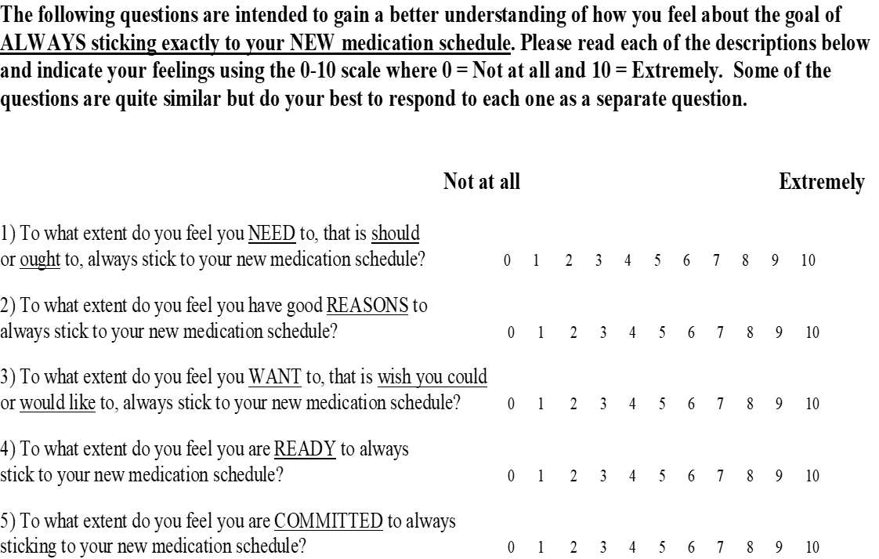
Notes:
Motivation/readiness/confidence to adhere. Look at predictive validity versus how well patients adhere. Test for concurrent validity. Different for people in different stages of the “stages of change”.
Concurrent: self-efficacy, autonomy, locus of control.
Discriminant validity: not related to education.

Slide 63
Measurement Validity
Consequences evidence –
“… includes both positive and negative anticipated and unanticipated consequences of measurement.”
How do the use of measures affect respondents?

Slide 64
Measurement Validity
Evaluation of measurement validity
For content, response process, internal structure, and consequence –
Subjective, depends on logical judgment by researcher
Relations with other variables –
Often correlations
Judgment; no established cut-offs
Notes:
For four of these, it is largely a subjective assessment. Others involve relations (often correlations). There is no official dividing line for these correlations to establish valid versus not valid.

Slide 65
Measurement Validity
Evaluation of measurement validity
Cohen’s guidelines – strength of relationship
Correlation coefficient – most common
Applied behavioral sciences
r >= .5 <U+F0E8> large effect / strong support
r > .3 <U+F0E8> acceptable level of support
r > .1 <U+F0E8> weak support (if statistically significant)
Table 12.2

Slide 66
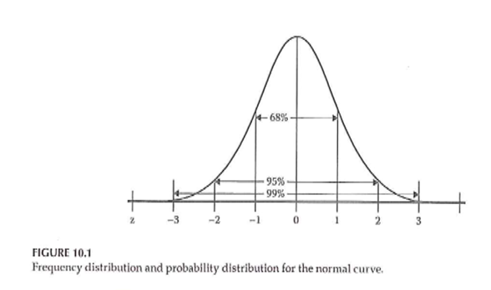
Measurement Validity
Notes:
Table 12.2 explains what each type of validity means.

Slide 67
Measurement Validity
Validity of diagnostic tests
Sensitivity
A test’s ability to obtain a positive result when the target condition is really present
True positive rate
Specificity
A test’s ability to obtain a negative result when the target condition is really absent
True negative rate

Slide 68
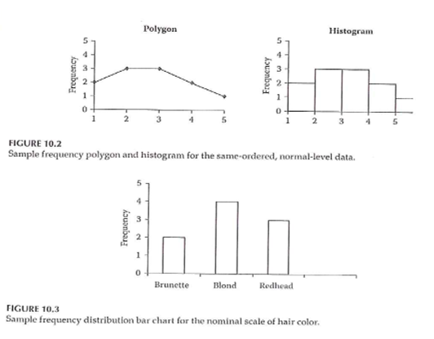
Measurement Validity
Notes:
Table 27.1 from Portney & Watkins, 2009
Sensitivity and specificity are not affected by prevalence. But prevalence plays a part in calculation of positive and negative predictive values.

Slide 69
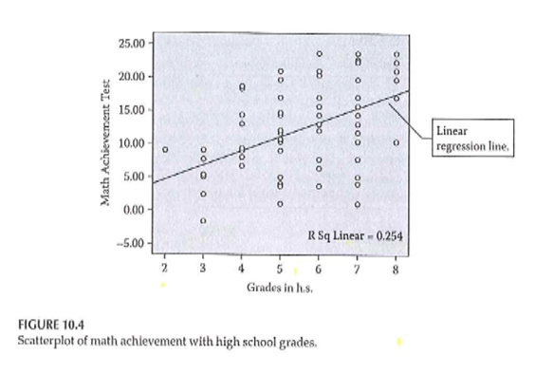
Measurement Validity
Notes:
Sim & Wright . 2000.

Slide 70
Measurement
Validity vs Reliability
The chicken and the egg!

Slide 71
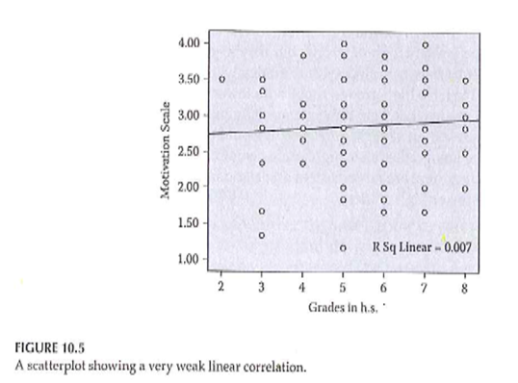
Measurement
Notes:
Figure 6.1 from Portney & Watkins, 2009. Not valid, not reliable. Valid, not reliable. Not valid, reliable. Valid, reliable.

Slide 72
Measurement
Validity vs Reliability
“ … a high degree of validity presupposes a high degree of reliability… ”
“ … reliability does not presuppose. ”
To establish reliability – only need to know where points are in relation to each other
To establish validity – need to know where the “ target ” is in order to evaluate how close points are to this “ target ”
Notes:
Sumary. Always start by establishing reliability (where the points are in relation to each other).

Slide 73
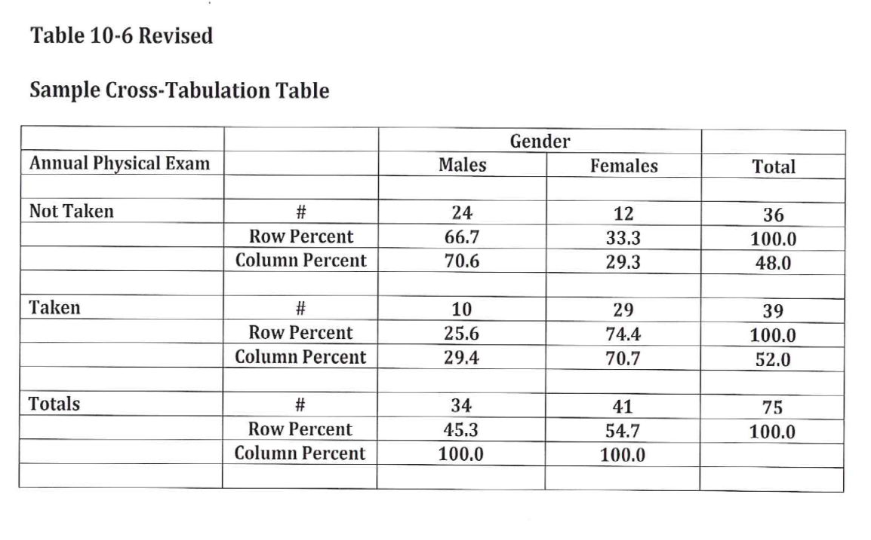
Measurement
Notes:
Validity vs Reliability (Table 9.1)
.footnote[Sim & Wright. 2000.]

Slide 74
Assignment #7
Generate a list of variables that you plan to include in your research proposal. Include in the list both dependent and independent variables. In the list include:
Variables you will need to describe your sample,
Variables you will need to control for in your analysis, and
Variables you will need in order to test your RQ/RH.
Notes:
RQ=research question, RH=research hypothesis.

Slide 75
Assignment
Generate a list of measures that you plan to include in your research proposal. This should be a general list of measures and not necessarily a detailed list of the specific type of measure to be used. For instance, you might list the outcome measure “health” and not specify the exact measure of health status that you will use. This assignment will be a first draft of the “measures” description included in the Methods section of your research proposal.
Prepare for next weekâ€™s session

Slide 76
Discussion questions
What procedures will you put into place in order to ensure reliability and validity?
How will reliability and validity be tested with the data that are collected?

Slide 77
Discussion questions
What can be done to address different threats to internal validity?
How would you evaluate the external validity of your research project?
How will you define the appropriate sample for your research project?

Slide 78
Additional slides

Slide 79
Additional issues to discuss
Validity. http://www.pmean.com/02/validity.html *** ### Measurement
What do we mean “ measurement ” ?
assignment of numbers or symbols to the different levels or values of variables according to rules. ”
Notes:
We are talking about measurement this week. You are either taking stats or have taken it in the past. This is not a statistics class. Think about what type of variables you will collect and propose what statistical analysis.
Your book defines it as the assignment of numbers or symbols. Notice that this takes a quantitative approach. But even in a qualitative study, you still going to want to summarize information like demographics of your sample. Describe the quality or quantity of a variable.
There are qualitative or quantitative ways to measure things like pain.
We can also use measurements to make absolute decisions. Establish a cut-point.
Conditions, distinctions.

Slide 80
Measurement
Assigning a number to represent …
Continuous value
Discrete value
Precision of measurement
Continuous variable …
Discrete variable …
Notes:
Value that is assigned can take on any value. Preciseness is dependent on the device used to collect the measurement. It could be the precision of a laser versus a cruder measure. Precision should be appropriate to what you are trying to get at. Lack precision does not mean that your results are not continuous. If you round to the nearest inch, you still are measuring an underlying construct that can take on more precision. Example is blood pressure, interbeat interval, where rounding is done but it still represents a continuous variable.
Discrete values because of rounding, using counts, or a limited number of categories. As long as it represents an underlying construct, consider it as continuous.

Slide 81
Measurement
What is the measurement representing?
Actual measurement …
Length, time, …
Indirect measurement
Constructs
Whatever you are trying to measure ..
Must be able to define it!
Notes:
A survey or scale to get at depression, pain, those kind of things. These are abstract variables.
Bottom line is to define and operationalize how you measure something. It’s easy to say something like quality of life but you have to pin this down and establish measurement validity. Consistency is important to avoid measurement bias.
Even for pretty obvious values like blood pressure, there are different ways to measure and you need to choose a single method for consistency and careful control, and when there are multiple methods, chose the method that is optimal for your needs. Blood pressure, for example, can be influenced by whether you are sitting or standing and whether you are talking while the measurement is being done.
Formalizing the rules for measurement helps reduce bias. This is a real concern when you have a variety of people doing the same measurements. How are new hires trained? Can you verify that they are trained to the standard that you have promised.

Slide 82
Measurement
Traditional levels (scales) of measurement
Nominal
Ordinal
Interval
Ratio
Notes:
Nominal means names, classification, or categorical assignment. Names are mutually exclusive and exhaustive. Value that is shown is a number code or a text word.
Ordinal is similar to nominal plus some orderliness as to what those responses mean. Example five point scale.
There is no true zero point. Can’t perform arithmetic operatitons on ordinal variables.
You can talk about the direction of change.
Interval - difference between levels is consistent across the range of the scale.
Ratio. There is a true zero point.

Slide 83
Measurement
Authors categorization of levels of measurement
Nominal
Dichotomous
Ordinal
Normally distributed
Table 10.1
Notes:
Gliner et al have a slightly different take. They talk about a normally distributed scale. It is hard to talk about the difference between ordinal and interval.
Look at the literature in the area you work with. Several Likert scales summed to get a subscale.

Slide 84
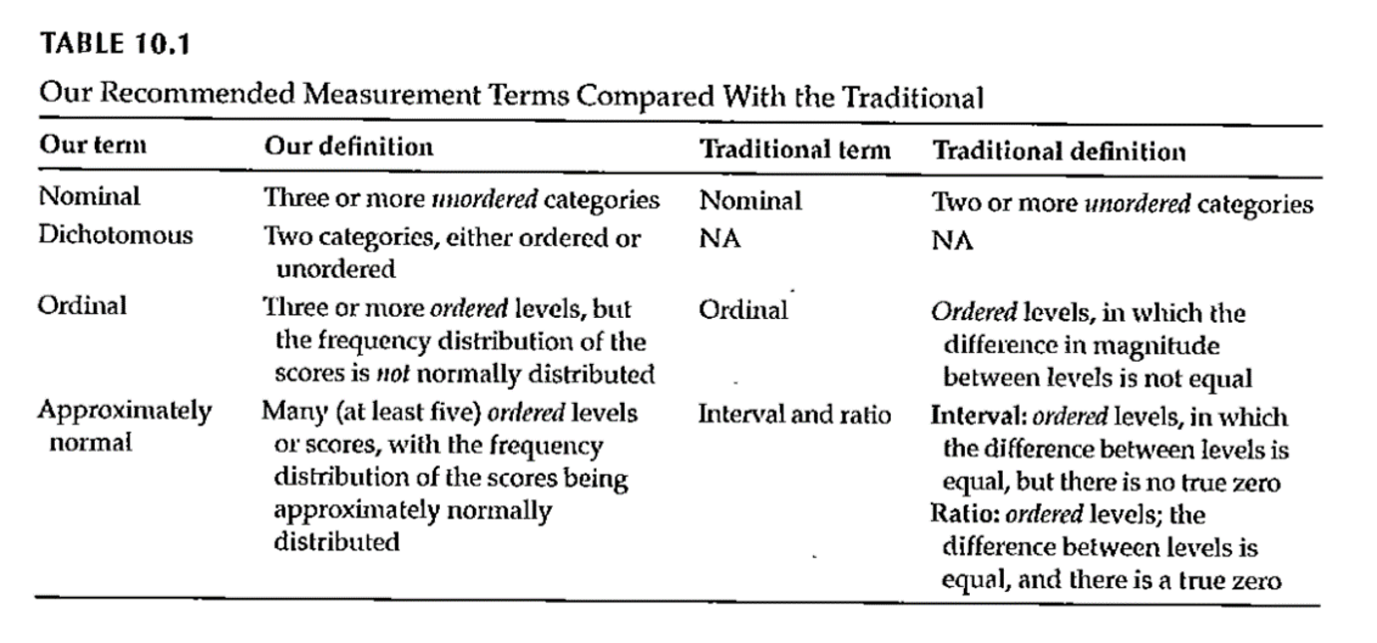
Measurement
Notes:
Table 10.1. This scale splits nominal into those with two levels (dichotomous, also known as binary) and more than two levels (nominal).
Remember how you coded nominal variables. You can (and should) use zero-one coding for dichotomous variables.
The average of a zero-one coded variable represents a probability.
Approximately normal scale requires at least five levels accorind to Gliner et al.

Slide 85
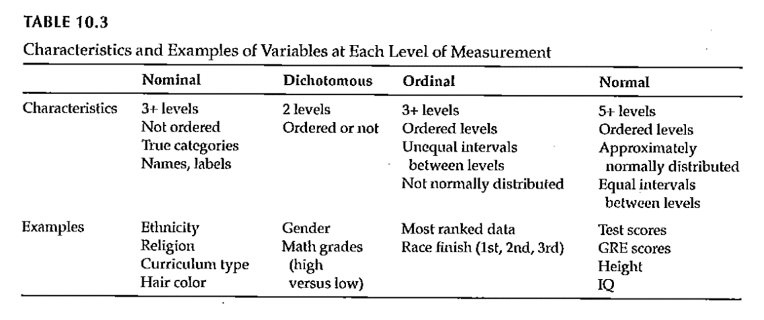
Measurement
Notes:
Table 10.3 gives examples of the Gliner et al scales.

Slide 86
Measurement
Why does the scale of measurement matter?
How it reflects your design and your research question
How it determines the types of statistical analyses you will do
How it defines what you can say about your results
Notes:
The level of measurement comes from what you are trying to get at in your research.
Measurement scales can limit what you can say about your results.

Slide 87
Assignment #6
Prepare a brief paragraph that describes the research design you are using for your research proposal. This is the information that will probably appear in the Methods section of your proposal.
Notes:
Go back are refer to Figure 4.1. Week 8 activities relate to the exemplar articles. These are on the Canvas site. There are six included. Pick one and get familiar with it.

Slide 88
Assignment
Prepare a brief paragraph that describes the research design you are using for your research proposal. This assignment will be used to describe the study design in the Methods section of your research proposal.
Prepare for next weekâ€™s session

Slide 89
Discussion questions
What kind of measurements will you use to collect data?
If you would need to use a survey or questionnaire to do your own research study, what topics would you need to cover? Are there existing measures that could be used?

Slide 90
Additional slides

Slide 91
External Validity
Generalizability
Fig. 9.3
Evaluating Research Validity Framework
Two main aspects
Population external validity
Ecological external validity
Notes:
The extent to which results can be generalized beyond this study. Extrapolate to the bigger world.
Evaluating freamework (questions 14 and 15).
Population: how participants were selected.
Ecologic validity: the more control you have, the better the internal validity but the less like it is for real world. The naturalness of the setting, rapport.
Figure 9.3.

Slide 92
External Validity
Population external validity
How participants were selected for the study?
Is sample representative of the target population?
Validity framework

Slide 93
External Validity
Ecological external validity
Whether the results can be generalized to real-life outcomes
Trade-off with control of study
Validity framework

Slide 94
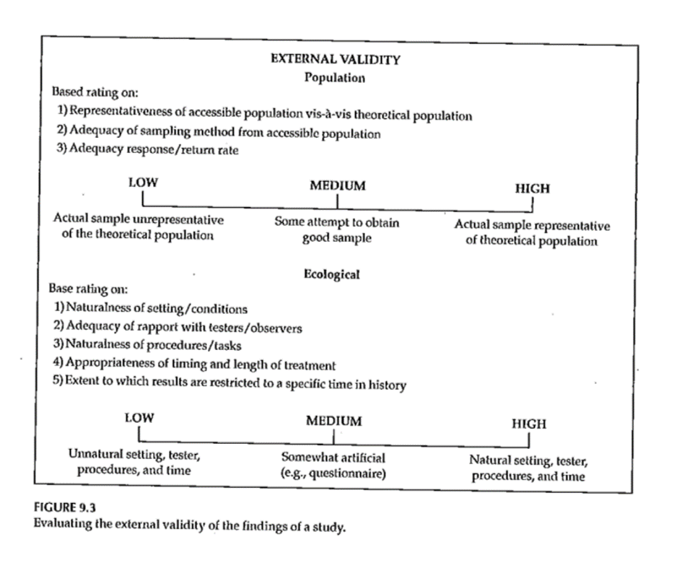
External Validity

Slide 95
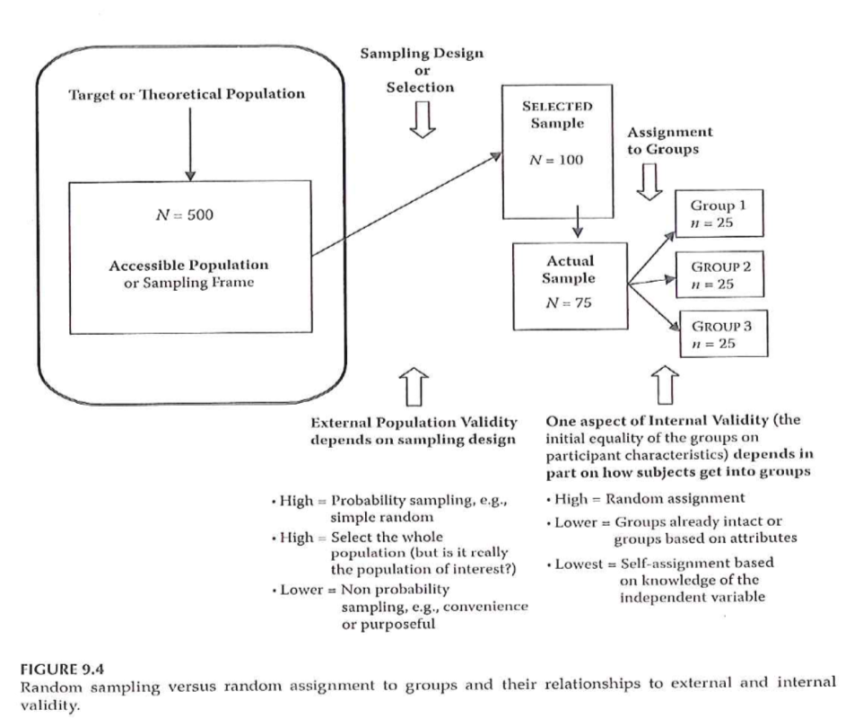
Sampling and Validity
Notes:
Figure 9.4. External validity is influenced by the sampling process. Internal validity is influenced by the allocation of this sample to treatment groups.

